Slide 1


Unit 4
HHFA CSPro Tool
Notes:
Welcome to Unit 4 of Module 3.

Slide 2
By the end of this unit, you will be able to:
describe the HHFA CSPro tool
Notes:
By the end of this unit, you will be able to describe the HHFA CSPro tool.

Slide 3
HHFA CSPro tool
1
2
3
4
5
6
7
Decide information needs
Adapt questionnaire & CSPro tool
Train data collectors
Collect data
Analyse data
Interpret, communicate & use data
Curate data
CSPro tool
Notes:
The HHFA CSPro tool is a tool to support Step 4 in the 7 key steps of the HHFA.

Slide 4

What is CSPro?
The Census Survey and Processing system (CSPro) is:
an opensource software package
developed by the US Census Bureau specifically for surveys
Notes:
The Census Survey and Processing system, or CSPro, is an opensource software package developed by the US Census Bureau specifically for surveys.

Slide 5
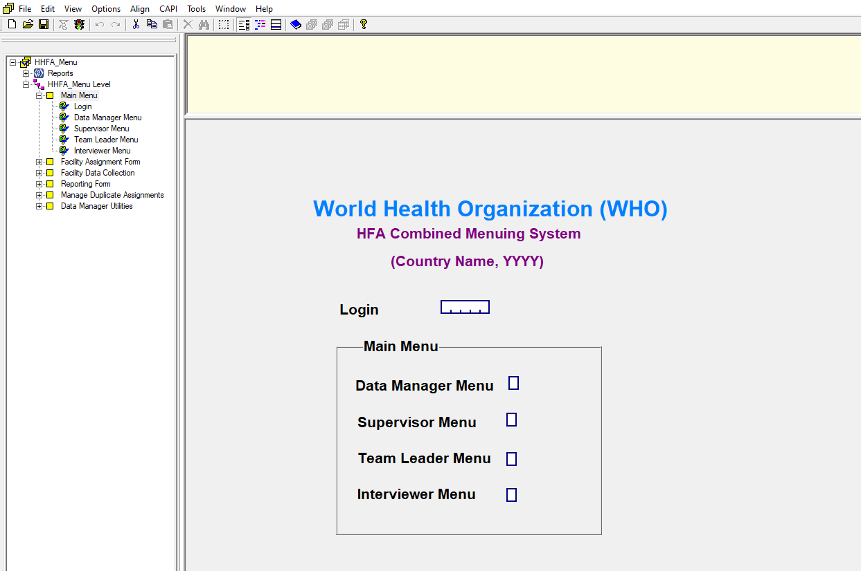




What is the HHFA CSPro tool?
Notes:
The HHFA CSPro tool is a standard application developed in CSPro to contain the HHFA questionnaires.
All the questionnaires are programmed into the CSPro tool.

Slide 6


What is the HHFA CSPro tool?
HHFA questionnaire country adaptation
HHFA CSPro tool
country adaptation
Notes:
For each country HHFA, after the questionnaire has been adapted to the country context, the CSPro tool is also adapted accordingly.

Slide 7
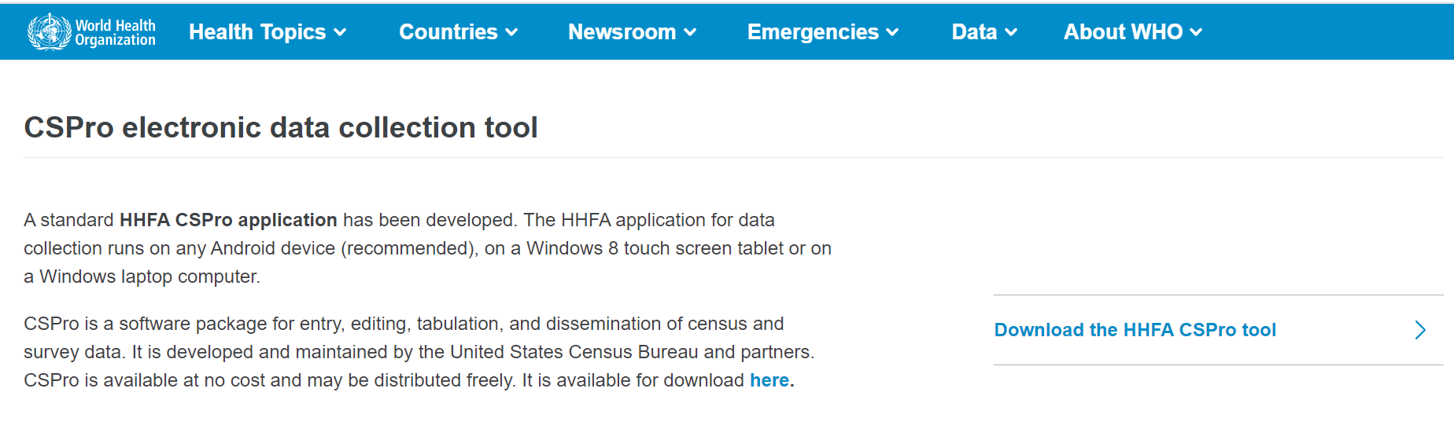
What is the HHFA CSPro tool?
https://cspro.hhfa.online/
Notes:
The HHFA CSPro tool can be downloaded from cspro.hhfa.online, or by going to the WHO HHFA webpages.

Slide 8



Collecting HHFA data using the CSPro tool
HHFA
questionnaires
HHFA CSPro tool
Handheld
devices
Data
collection
Country HHFA
server
Notes:
The CSPro tool is loaded onto mobile phones or tablets, which the data collectors use to complete the questionnaire when they visit a health facility.
The completed questionnaires are uploaded to a dedicated HHFA server that the country sets up to compile all the HHFA data for processing.

Slide 9

Key point
Detailed information on how to adapt and use the HHFA CSPro tool is found
in the HHFA Data Manager Guide.
Notes:
Detailed information on how to adapt and use the HHFA CSPro tool is found in the HHFA Data Manager Guide.

Slide 10
You have now completed Unit 4.
In the next unit, we will look at the HHFA data analysis platform.
Notes:
You have now completed Unit 4.
In the next unit, we will look at the HHFA data analysis platform.

